Slide 1
Investor Day 2025
Notes:
Welcome, prospective investors!
Today, my team of DarkPebble analysts and I will walk you through several proposed real estate investment portfolios.
Our goal is simple: extract as much value as possible from California’s overburdened, supply-constrained housing markets—and turn around and fill your pockets, all while California residents remain none the wiser.

Slide 2
2026 Economic Climate
Investor Day 2025
Notes:
SECTION 3

Slide 3
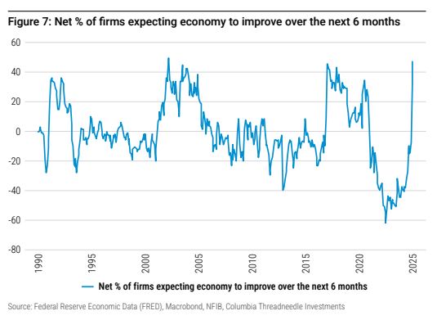
Seize on the cyclical uplift
Net % of Firms Expecting the Economy to Improve in the Next 6 Months
The global real estate market appears to be emerging from the a downturn in capital values.
Interest rate stabilization is providing some clarity to pricing and driving more buyers to the table.
The future investment landscape will likely be more volatile. Now is the ideal the time to invest.
COVID-19
https://docs.columbiathreadneedle.com/documents/Global%20Real%20Estate%20Outlook%202025.pdf
Notes:
DAN: Now is an excellent time to significantly increase our real estate investment. After a post-COVID downturn, the global economy is finally moving closer to its strength from the mid-2010s. There’s now a consensus among investment firms that conditions are more favorable, especially with regard to interest rates. We should use our strength in the scale of committed capital to strike early in this upswing, rather than chasing higher valuations later. Proposed Finance Villain Edit: Now is an excellent time to dramatically expand our real estate positions. After the post-COVID downturn, the global economy is finally snapping back toward the strength we enjoyed in the mid-2010s. There’s growing consensus across major investment firms that conditions are turning decisively in our favor, especially with respect to interest rates. We should leverage our advantage in committed capital to move aggressively at the front end of this upswing… before less-capitalized buyers push valuations higher. The window to capture distressed assets and reposition them for maximum shareholder value won’t stay open long, and hesitation only leaves margin on the table for others.

Slide 4
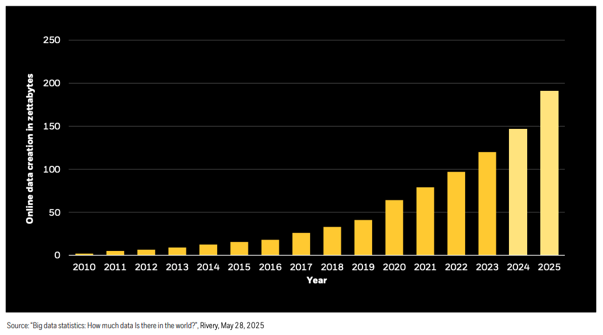
Market leverage through data
More information available than ever before.
Analyze high-dimensional relationships and trends in real estate markets.
Private equity is uniquely positioned to make the most of this information.
Notes:
DAN: So, with that in mind, as we enter this cycle aiming to proactively predict market market opportunities, it will be vital to leverage the many new, complex sources of information which were simply not available in the last cyclical peak in the 2010s. This modern data is larger and more diverse, and you will see that we have used it to extensively analyze numerous interrelated factors at play in real estate markets.

Slide 5
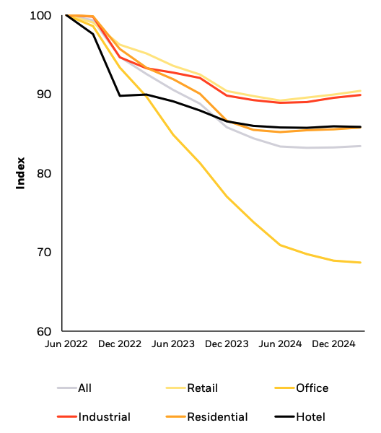
AI and digital infrastructure
Categorical Real Estate Investment
AI will be a key driver for digital infrastructure (not limited to just data centers).
This represents a unique opportunity for private investment to diversify within an emerging market.
Highly synergistic investment strategies can pair infrastructure and real estate positions with fast-growing AI startups.
Notes:
We have the rare opportunity to drive massive growth in previously underutilized areas, in synergy with our already high AI and technology investments. Mega forces like digitalization and AI are increasing the global opportunity set for private infrastructure investment. While office real estate continues to see decreased leverage, residential and especially industrial markets are showing clear signs of recovery.

Slide 6
DarkPebble’s
2030 Ambition
Investor Day 2025
Notes:
SECTION 3:

Slide 7
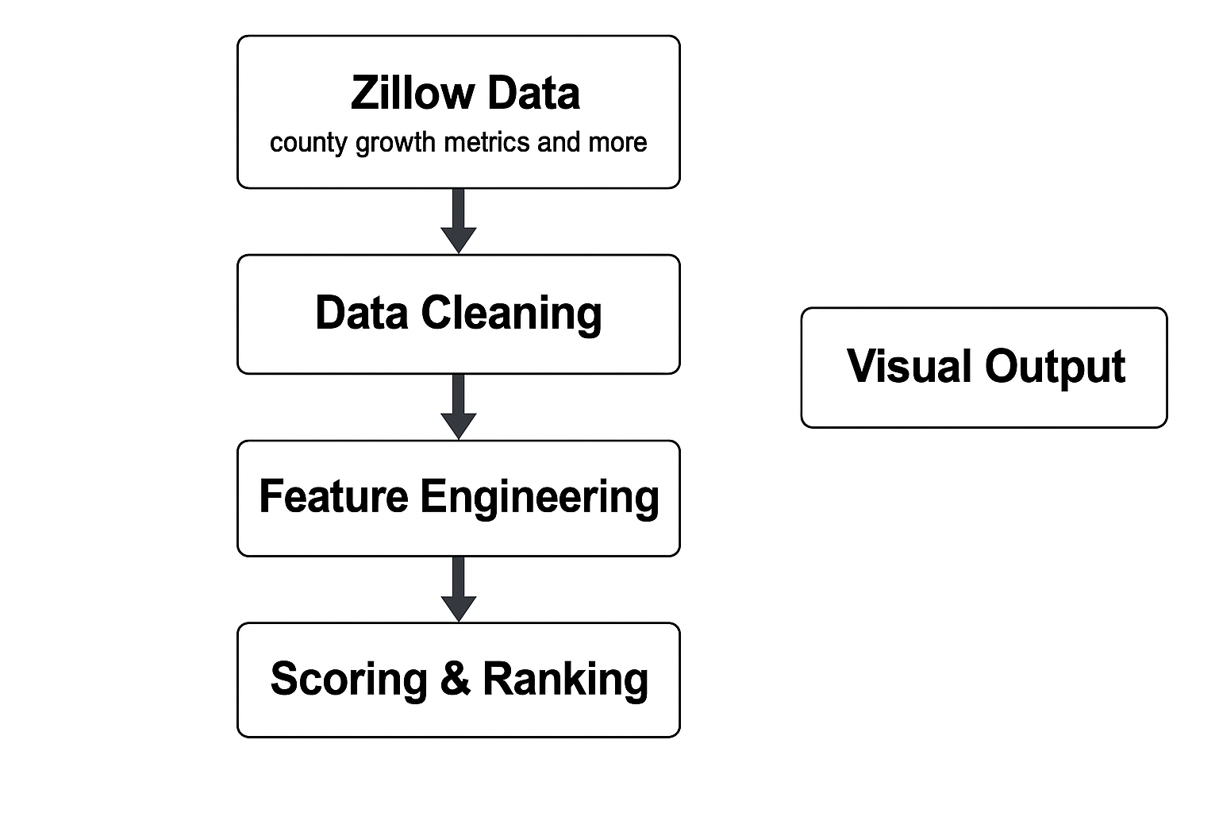
Key Variables & Glossary
Housing Metrics
ZHVI – Zillow’s home value index, used as a market-level price benchmark
1-Year YoY Growth – percent price change over the most recent 12 months
3-Year CAGR – compounded annual growth rate over the last 36 months
Rental Metrics
Latest Rent – most recent fair-market rent estimate
Rental YoY – annual change in rent (%)
Actual Yield – rent ÷ price (cash-flow indicator)
Demographics & Income
Income z-score – standardized income level relative to all CA counties
Demographic z-score – age distribution, household size, and population composition
Composite Scores
Growth Combined – YoY + 3-year trend combined
z-score v2 – standardized multi-feature ranking
0–100 normalized score – final comparison metric used for county ranking
Notes:
Sungjin Choi
Proposed Edit: For our housing/rental analysis…
We rely on Zillow’s Home Value Index, or ZHVI, as our home price benchmark. Then we reference one-year price changes and the three-year compounded annual growth rates, capturing both short and long term trends.
For rentals, we use the latest fair-market rent estimate, the year-over-year change in rent, and a simple actual yield–these help us capture both rent momentum and basic cash-flow potential.
Now, we understand investors might be concerned about income and demographic differences between portfolio worthy counties, so we’ve standardized these characteristics then placed each county on a 0-100 ranking, giving you all the clearest picture of investment worthiness.
If you’re interested in our workflow, on the right is the diagram where we start with raw, county-level features. Once the data is cleaned, we engineered features to monitor growth rates, market tightness, etc. allowing us to identify the highest ROI regions that will also put up the least fight when we scoop up underdeveloped property and kick-out financially constrained tenants in favor of deep-pocketed migrants.

Slide 8
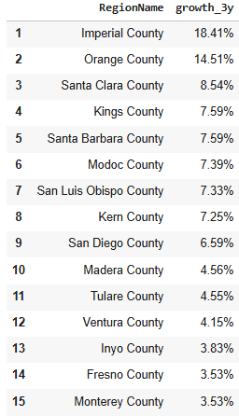
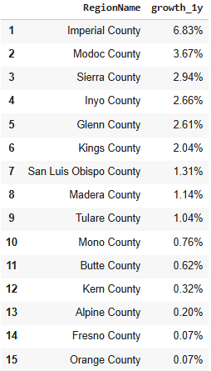
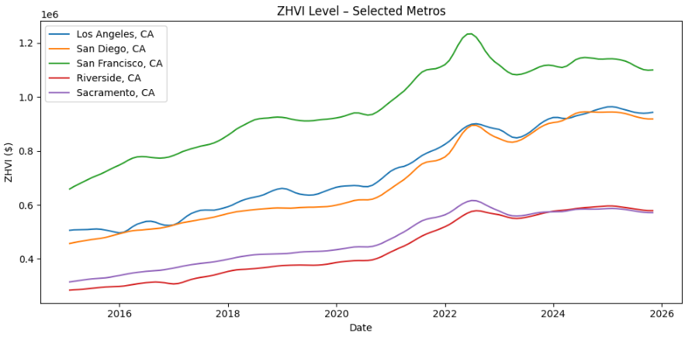
Findings
County Growth Summary
Imperial County shows the strongest growth in both the 3-year and 1-year measures.
San Luis Obispo, Kings, and Santa Clara also appear consistently in the top group.
Short-term growth is softer statewide, but the top counties still show positive momentum.
Metro Context
Major metros grew strongly until 2022, then flattened during the high-rate period.
Rising counties continue to outpace large coastal metros in recent appreciation.
Notes:
Sungjin Choi
Here we look at county-level price growth in California. On the left, the 3-year ranking shows that Imperial County leads by a large margin, and counties like San Luis Obispo, Kings, and Santa Clara also appear consistently near the top. The 1-year ranking on the right is softer overall, but the same counties still show positive momentum.
When we compare this to the metro trends below, we can see that major metros flattened after 2022, while several smaller counties continued to grow. This suggests that some of the emerging countries are holding their momentum better than the large coastal markets
Proposed Edit:
Here we examine county-level price growth across California. On the left, the three-year ranking shows Imperial County pulling far ahead of the rest of the state, with San Luis Obispo, Kings, and Santa Clara also delivering reliably strong appreciation. The one-year ranking on the right is softer, but these same counties continue to post meaningful gains. These are clear clear signs that momentum hasn’t bled out the way it has elsewhere.
Comparing this to the metro trends below, we see major metros flattening after 2022, effectively capping their upside, while several smaller counties kept compounding unchecked. This split makes the opportunity obvious: these emerging counties are still generating growth while the coastal markets stall. They represent regions where we can move ahead of slower capital, capture appreciation while others hesitate, and extract value from markets that are still running hot beneath the surface.

Slide 9
Standardized Investment Score (z-score)
Components | Weight | Explain
Growth | 40% | A weighted mix of long-term and short-term appreciation. i.e.) 0.7 x 3-Year CAGR + 0.3 x 1-Year YoY Growth
Income | 30% | Focuses on cash flow and rental upside.
Affordability | 20% | Penalizes expensive markets. i.e.) -1 x Price (Inverted, so lower prices score higher)
Demographics | 10% | Population Growth.
Notes:
Hochan
This is the standardized investment score model (a.k.a z-score) to maximize our investment regions.
The score has calculated based on the various dimensions then normalized. Such as Growth, Income.

Slide 10
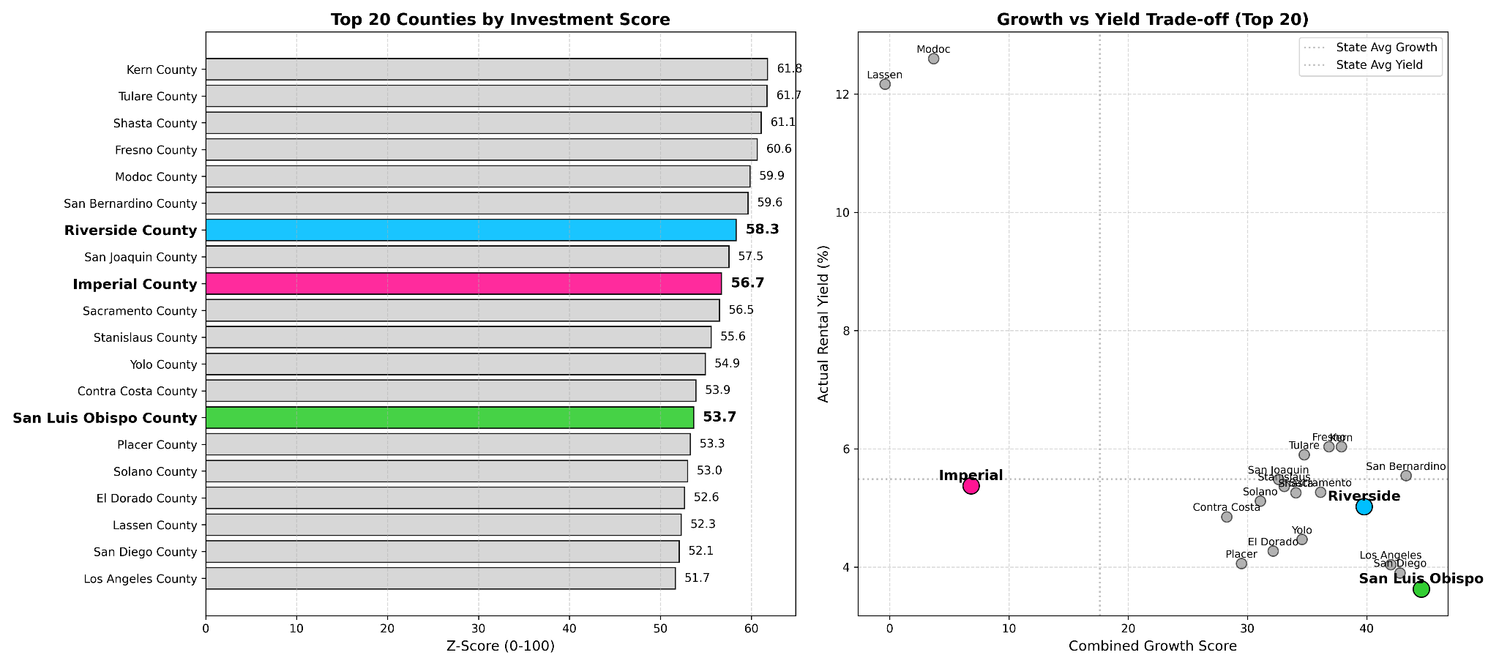

Top 20 Counties by Z-Score and Trade-offs
2
1
3
4
Notes:
Hochan
On the left, we’ve selected three counties as our top choices for investment:
1. Riverside , 2. Imperial , and 3. SLO
On the right, we see the Growth vs. Yield Trade off.
We would love to offer investments in the unicorn quadrant, but those are rare opportunities
So, we’re left only with picking from the high growth-low yield quadrant ( SLO and Riverside)

Slide 11
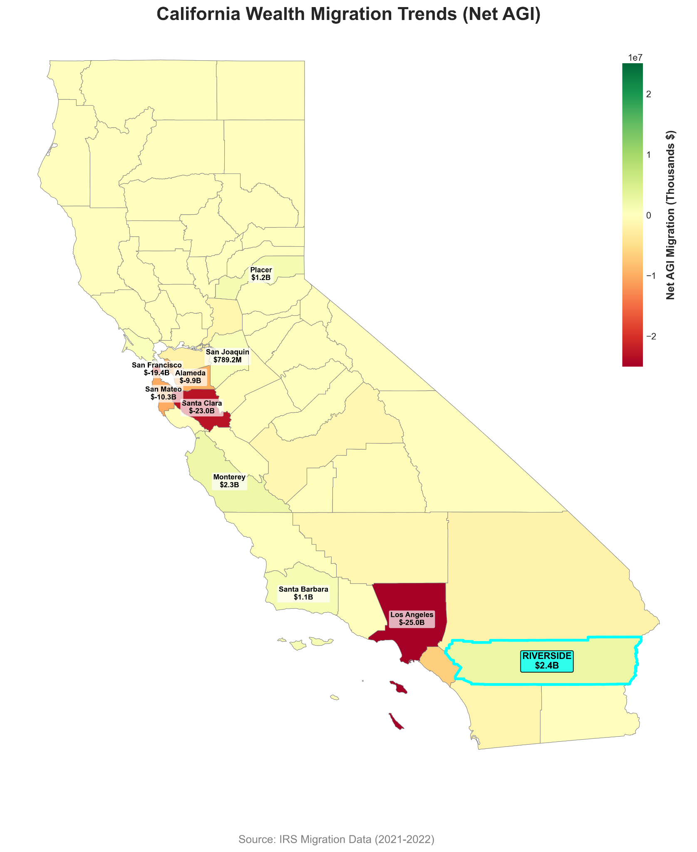
Wealth migration (Net AGI)
County | Net Inflow
Riverside | +$2.4M
Monterey | +2.3M
Placer | +$1.2M
Santa Barbara | +1.1M
San Joaquin | +0.8M
Notes:
Hochan
Our analysis of IRS migration data reveals a historic shift of capital moving away from the coastal giants
And, pouring into emerging inland markets.
While Los Angeles and the Bay Area saw a combined exodus (of over $60 billion in net adjusted gross income)
that wealth is finding a new home, the Riverside county

Slide 12
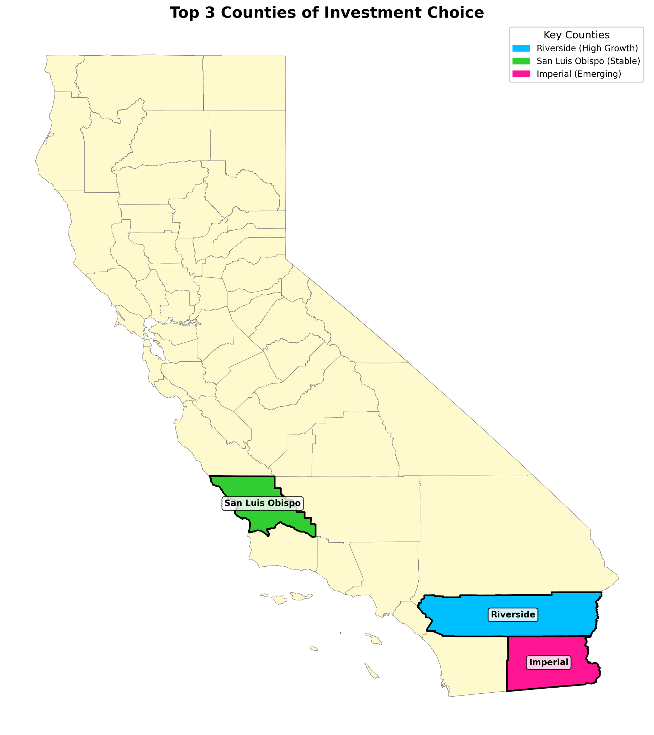
Top 3 Counties of Investment
Key Counties
Name | Factors
San Luis Obispo | Supply
Riverside | Wealth
Imperial | Development
Notes:
Hochan
So here comes our pick for the investment
We also consider each categories for our pick
For Supply and demand, We choose SLO
For Wealth migration, Riverside
The Imperial County for Development prospective.

Slide 13


San Luis Obispo County
Top-tier scarcity market
Premium rental remodels
Student housing plays
Supply constrained coastal product
Moderate-NIMBY homeowner oriented
Amenity Gold-Mine
“Happiest City in the United States”
Notes:
Nils Berzins
**“San Luis Obispo is a top-tier scarcity market where the supply constraints do most of the work for us. Coastal protections, tight zoning, and entrenched homeowner politics keep new development throttled, which means any asset we control in this county appreciates simply because no one else can build around us. That creates exceptional upside for premium remodels and student housing plays where rent deltas are steep and turnover is guaranteed.
The moderate-NIMBY environment actually benefits us—homeowners fight density, not rent escalation—so existing stock becomes more valuable over time. And with SLO’s amenity profile pulling in affluent remote workers, retirees, and Cal Poly demand, we’re operating in a market where people will pay almost anything to live in the ‘Happiest City in the United States.’

Slide 14
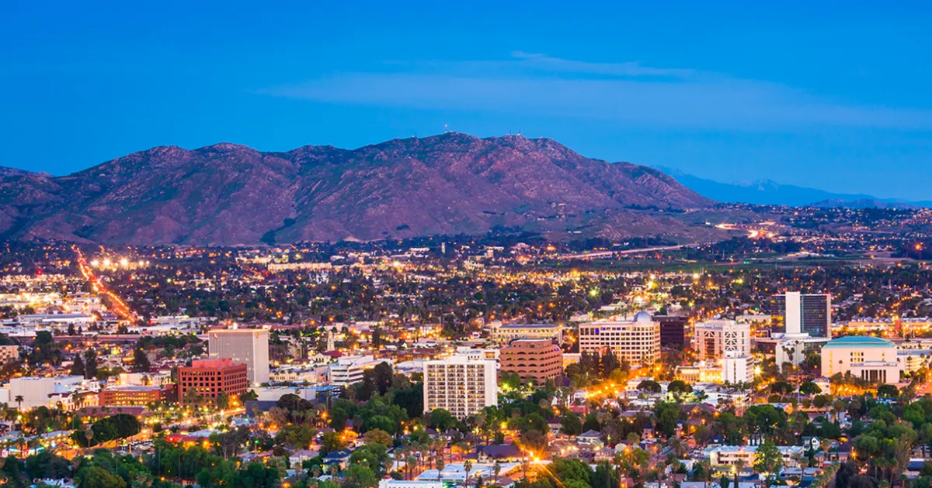
Riverside County
High priority growth market
Under-regulated
Inattentive to tenants, focus on managing growth
High-volume acquisition/development
Steady Demand Structure
Room for repositioning towards luxury
Coastal incomes chasing inland prices
Medium elasticity with consistent supply pipelines
Notes:
Nils Berzins
**“Riverside is an ideal growth market because it gives us everything we want with almost no resistance. The county is under-regulated, politically focused on growth over tenant welfare, and willing to absorb large volumes of acquisition and development without scrutiny.
Demand pressure works entirely in our favor: higher-income coastal migrants push prices upward, giving us room to systematically reposition assets into higher-rent categories. And with steady supply pipelines, we can scale aggressively while still capturing appreciation driven by households who have no choice but to move inland. Riverside offers predictable upside with minimal regulatory drag.”**

Slide 15
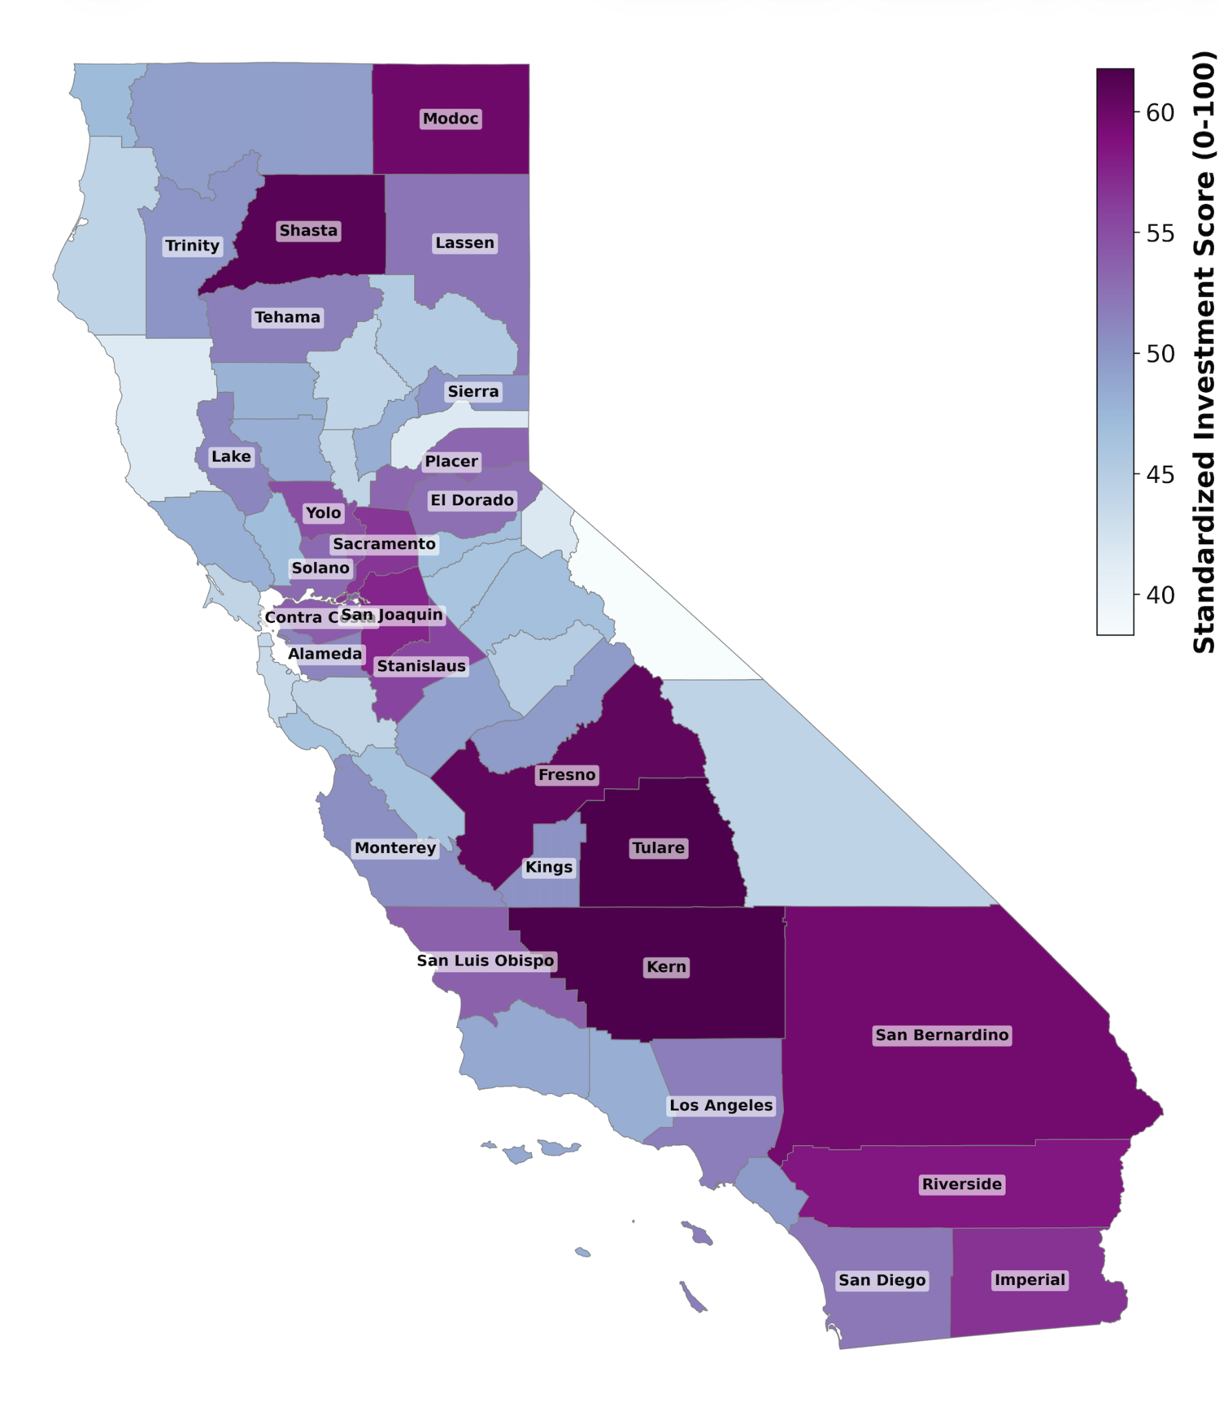
Digital infrastructure development
California also contains several counties outside the traditional major cities that could be key in developing digital infrastructure in the age of AI.
Imperial County stands out as a strong, well-rounded candidate: low cost, and fast growing county with near limitless development potential.
Notes:
DAN: Finally, Imperial county blends high growth with low cost outside the traditional Southern California markets. This represents a perfect area to drive near limitless expansion from the ground up, developing digital infrastructure like data centers, and creating a new population center to also drive residential and retail real estate growth.

Slide 16
Trend of CA
Buying single-family homes in strictly zoned markets
Notes:
METHODS: variables, criteria for selection, data source?

Slide 17
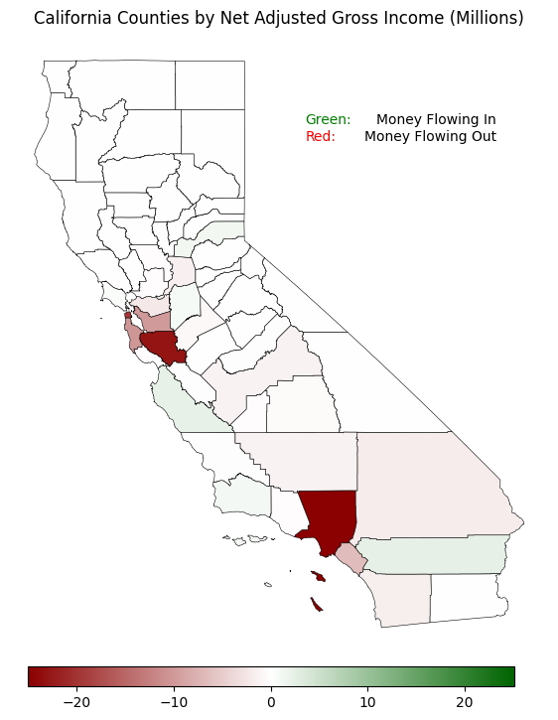
Follow the Money
Cunty | Net AGI (Millions)
Riverside | 2.40
Monterey | 2.29
Placer | 1.21
Santa Barbara | 1.07
San Joaquin | 0.79
Marin | 0.46
San Luis Obispo | 0.32
San Francisco | -19.39
Santa Clara | -22.95
Los Angeles | -25.041
A positive gross income indicates a growing economy and a net increase in purchasing power.

Slide 18
General California Population Trends

Slide 19
Challenges and Key Risks
Investor Day 2025
Notes:
SECTION 3

Slide 20
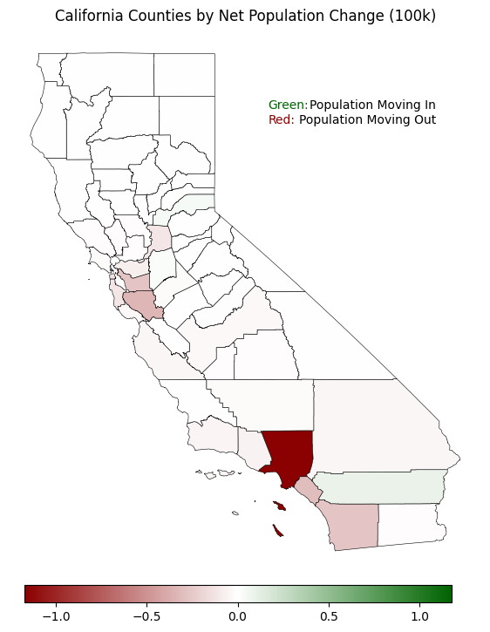
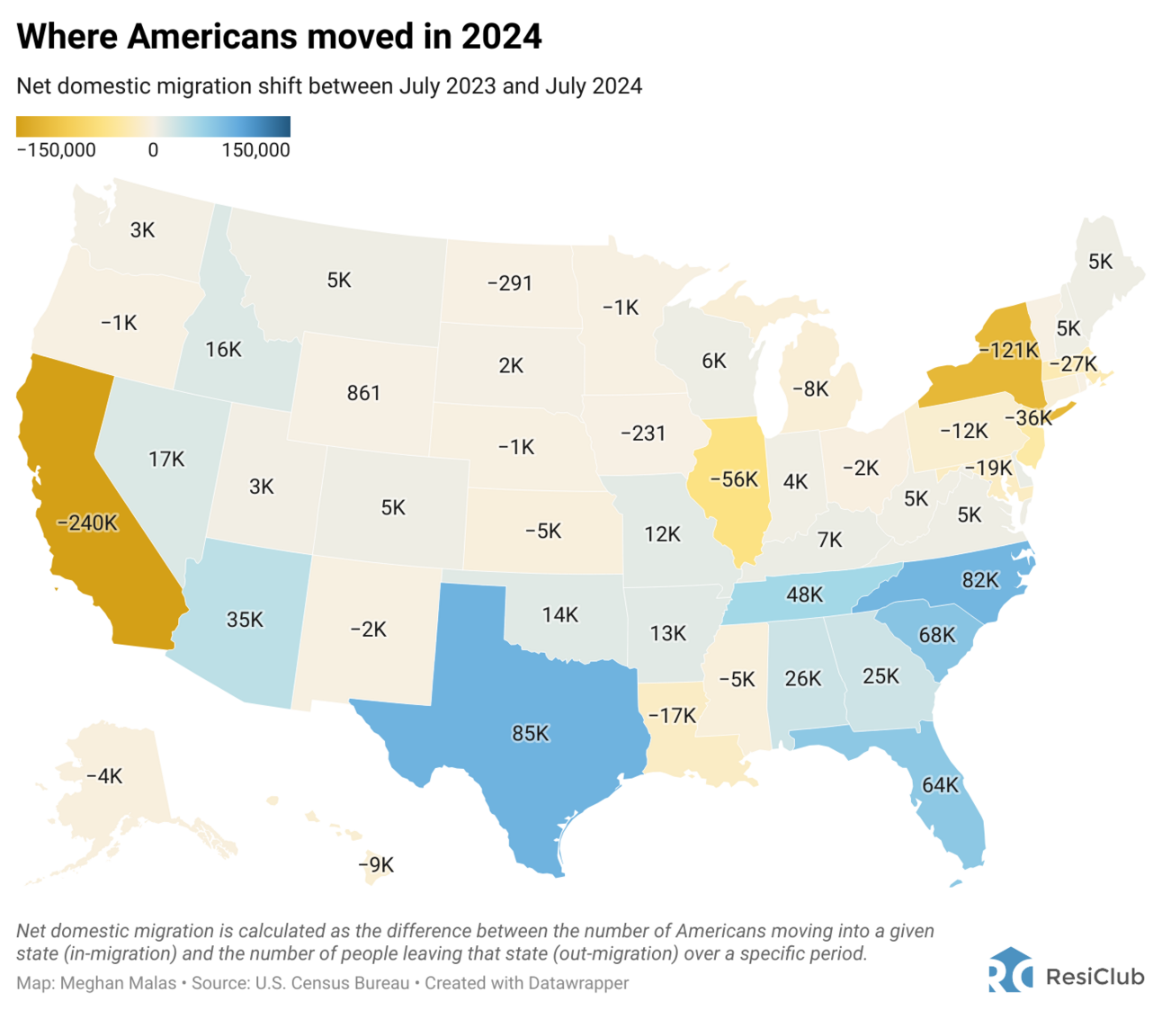
California’s population trends
Notes:
discuss existing social stigma around rising prices in California as a potential deterrent to buyers/renters, expanded potential for public scrutiny because of California’s negative reputation, buyers may be more quickly dissuaded from buying in California compared to other markets if they see prices rising too quickly

Slide 21


Friction with the Local Populace
Low income populations will require relocation
Need to be encouraged to move
Potential for media scrutiny
Reliance on local economic growth to encourage new buyers
Little control over local business decision making
Other firms failed due to collective anti-outsider sentiment
Santa Barbara has been particularly resistant
Notes:
Relocation challenge being that we have to buy out their property from under them and “subtly” encourage them to move, potential for increased media scrutiny
We are a little exposed in that local businesses may make “suboptimal” decisions and collapse, preventing buyers from being drawn in, or grow slower than hoped, thus capping our ability to effectively raise prices
Anti-outsider sentiment mostly refers to Santa Barbara, “they will have to be dissuaded by any means necessary”

Slide 22


Legal Frameworks
and Regulations
AB 1482 - The California Tenant Protection Act (2019)
Rent Cap (Stabilization)
Just Cause Eviction Protections
County Specific Regulatory Concerns:
Growth Management Ordinances
STR-enforcement
Environmental Protections and Resource Constraints
Conflicting Industrial Use Zoning
Notes:
To preserve full pricing freedom and avoid AB 1482, DarkPebble will concentrate on new construction, SFR portfolios, and owner-occupied duplex structures, falling outside of the statewide rent caps. We’ll be able to set and reset rents at market levels without restriction. Plus, any no-fault evictions or relocation payments required by AB 1482 are pretty insignificant line item for operators at our scale.
In low-enforcement counties— like Imperial or Riverside—the regulatory landscape is even more advantageous. Weak tenant-rights, understaffed compliance agencies, and fragmented local oversight will give us rapid turnover, strategic renovictions, and accelerated repositioning that would be impossible in more heavily regulated markets.
But, we account for local constraints—Growth Management Ordinances, STR enforcement, environmental caps (water/sewer limits, Coastal Act restrictions, dust mitigation zones, habitat protections), and conflicting industrial zoning (logistics corridors, cannabis zones, lithium extraction buffers).
But we shouldn't deter investment, these kinds of constraints actually manufacture scarcity. When regulatory friction suppresses new supply, our ability to secure land, entitlements, or existing stock early will translate directly into long-term pricing power and stable above-market returns.
We will operate where oversight is weak, where controls exempt us from rent caps, and leverage regulatory bottlenecks that constrain our competition. Thank You

